Slide 1
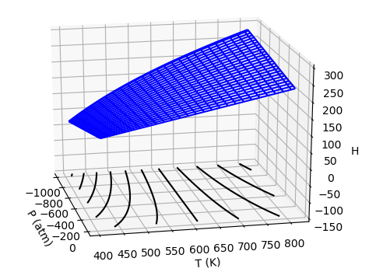

Across weeks – H(T,P) as a thermodynamic surface
$${\left(\frac{∂H}{∂T}\right)}_{P}$$
Which is the correct association?
Pressure
Temperature
$$dH=C_{P}dT+μ_{T}dP$$

Slide 2
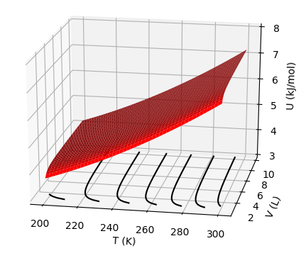
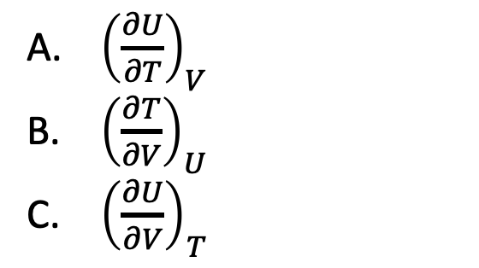
Across weeks – U(T,V) as a thermodynamic surface
Which is the correct association?
${\left(\frac{∂U}{∂T}\right)}_{V}$
${\left(\frac{∂T}{∂V}\right)}_{U}$
${\left(\frac{∂U}{∂V}\right)}_{T}$

Slide 3
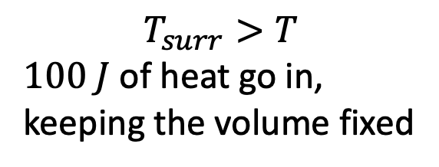
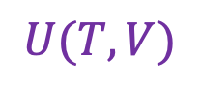
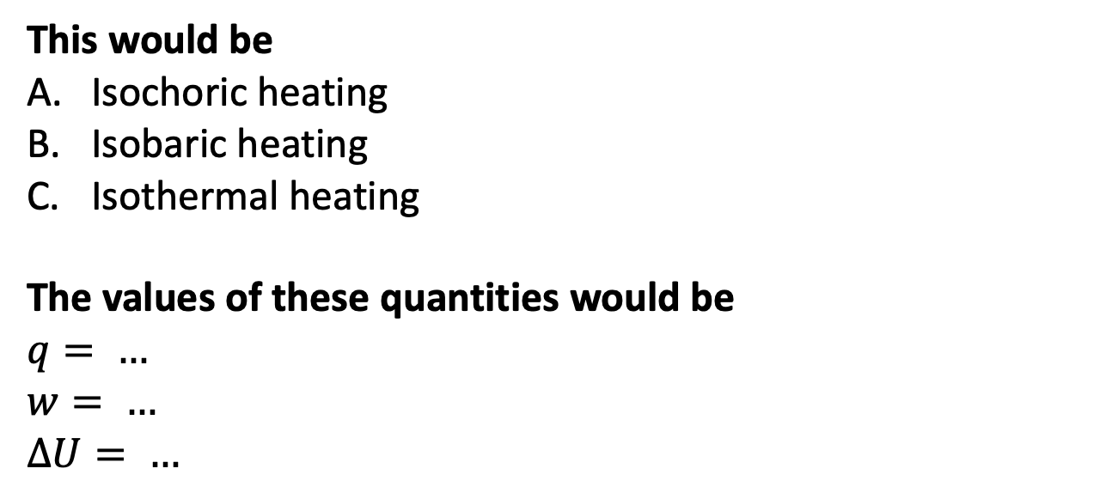
Week 6 - Applying the 1st law
$$T_{surr}>T$$
$100 J$ of heat go in,
keeping the volume fixed
$$U(T,V)$$
$$T_{surr}$$
V
This would be
Isochoric heating
Isobaric heating
Isothermal heating
The values of these quantities would be
$$q= …$$
$w= …$
$∆U= …$
T
T
(system)

Slide 4
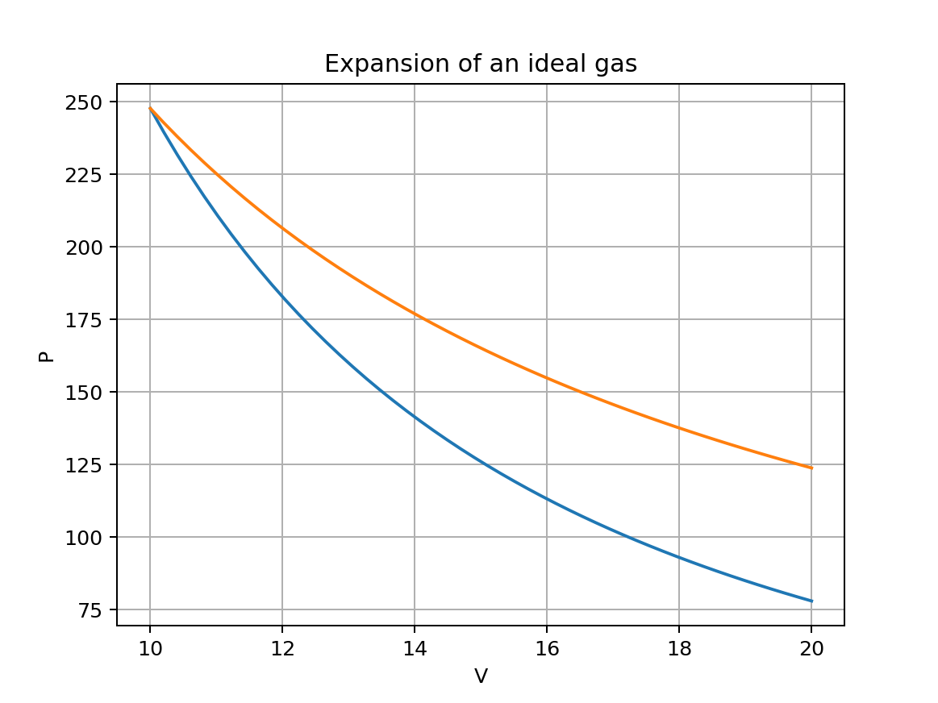
Week 6 – An expanding ideal gas (qualitative)
Starting from the marker, one curve is isothermal, the other is adiabatic.
Explain which is which, and why you think so.

Slide 5
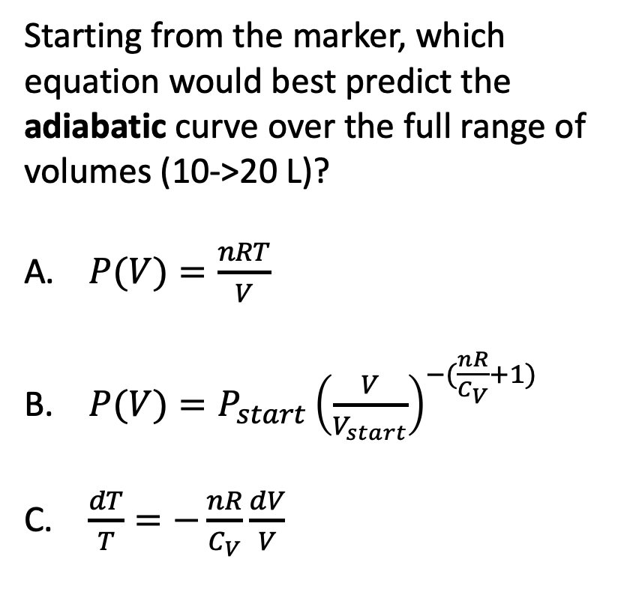
Week 6 – An expanding ideal gas (quantitative)
Starting from the marker, which equation would best predict the adiabatic curve over the full range of volumes (10->20 L)?
$P(V)=\frac{nRT}{V}$
$P(V)=P_{start}{\left(\frac{V}{V_{start}}\right)}^{−(\frac{nR}{C_{V}}+1)}$
$\frac{dT}{T}=−\frac{nR}{C_{V}}\frac{dV}{V}$

Slide 6
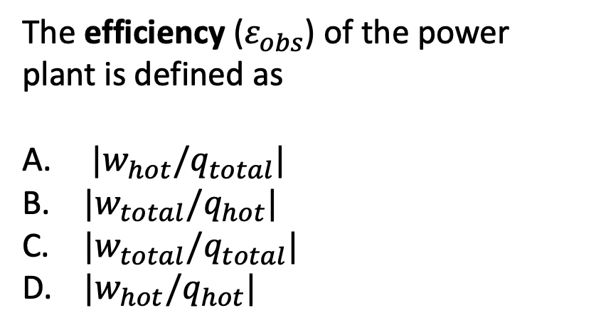
Week 6 – Heat engines (definition of efficiency)
The efficiency ($ε_{obs}$) of the power plant is defined as
${|w}_{hot}/q_{total}|$
${|w}_{total}/q_{hot}|$
${|w}_{total}/q_{total}|$
${|w}_{hot}/q_{hot}|$

Slide 7
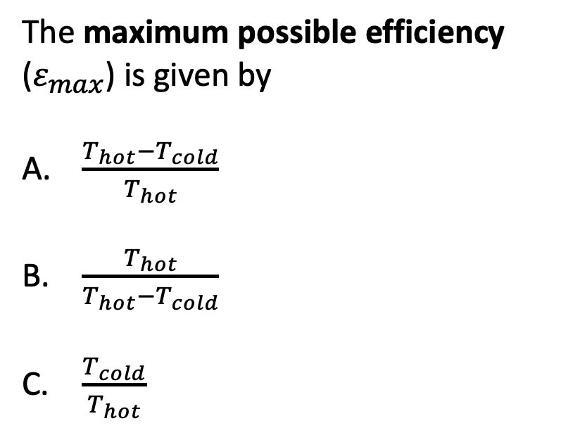
Week 6 – Heat engines (limit of efficiency)
The maximum possible efficiency ($ε_{max}$) is given by
$\frac{T_{hot}−T_{cold}}{T_{hot}}$
$\frac{T_{hot}}{T_{hot}−T_{cold}}$
$\frac{T_{cold}}{T_{hot}}$

Slide 8
Week 7 – Interpreting thermodynamic surfaces
The black lines are called
Isentropes
Isochores
Isobars
Isenthalps
Isotherms

Slide 9
Week 7 – Interpreting thermodynamic surfaces
The straight black line (at ~600 K) defines the
Critical temperature
Boyle temperature
Boiling temperature
Inversion temperature

Slide 10
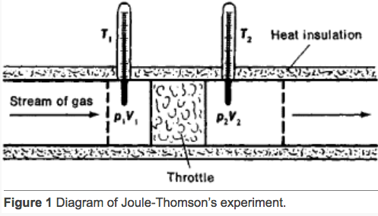
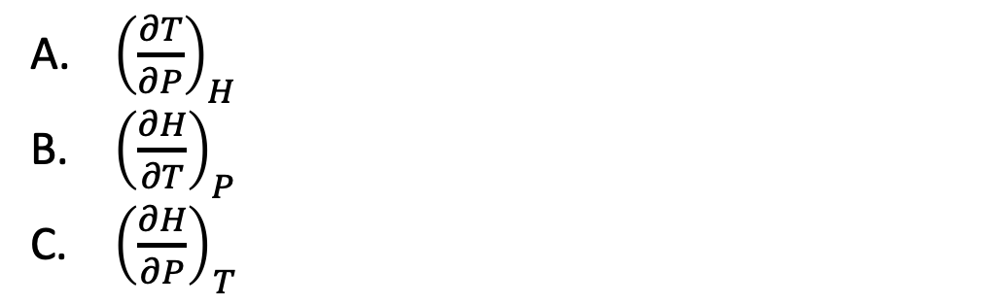
Week 7 – The adiabatic J-T experiment
We used the temperature of the CO₂ coming out of the tank to calculate $∆T/∆P$, which we equated to
${\left(\frac{∂T}{∂P}\right)}_{H}$
${\left(\frac{∂H}{∂T}\right)}_{P}$
${\left(\frac{∂H}{∂P}\right)}_{T}$

Slide 11
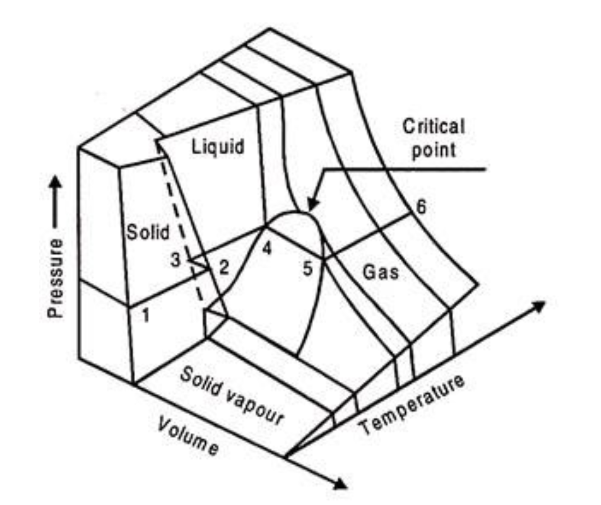
Week 7 – Corresponding states
gas
gas
liquid
liquid
Isothermal compression
The process on the left best corresponds to which curve on the right?
Red
Blue
Orange
Green
Black

Slide 12
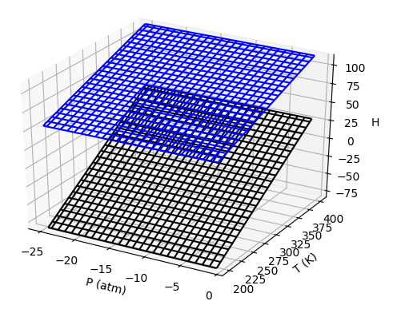
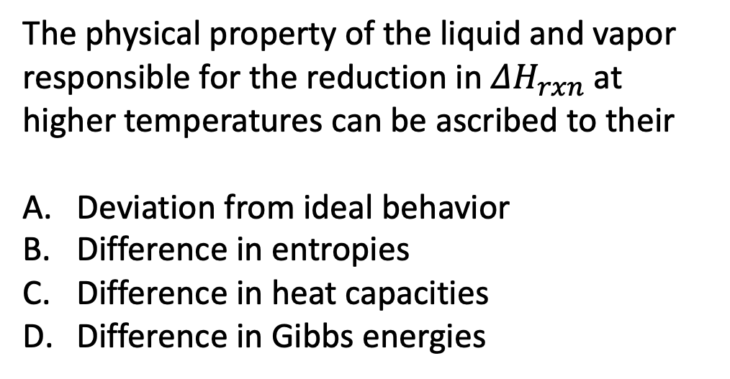
Week 8 - $ΔH_{rxn}$
Upper surface is vapor
The physical property of the liquid and vapor responsible for the reduction in $ΔH_{rxn}$ at higher temperatures can be ascribed to their
Deviation from ideal behavior
Difference in entropies
Difference in heat capacities
Difference in Gibbs energies
Lower surface is liquid

Slide 13
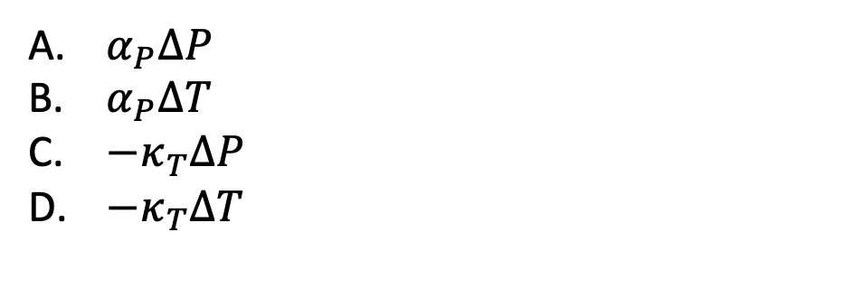
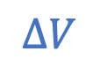

Week 9 – Expansivity and compressibility
$α_{P}≡\frac{1}{V}{\left(\frac{∂V}{∂T}\right)}_{P}$ , $κ_{T}≡−\frac{1}{V}{\left(\frac{∂V}{∂P}\right)}_{T}$
We said that for liquids and solids we can estimate the relative volume change associated with sea level rise due to climate change. Which is the relevant equation for $\frac{∆V}{V}$?
$$∆V$$
$α_{P}∆P$
$α_{P}∆T$
${−κ}_{T}∆P$
${−κ}_{T}∆T$
$$V$$

Slide 14
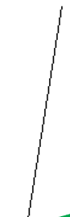
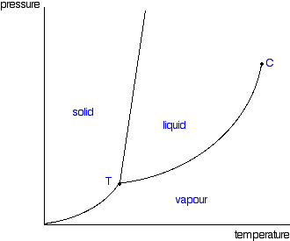
Week 9 – Phase diagrams
P
B (line)
Clapeyron
Clausius-Clapeyron
Raoult
Thomson
Clapeyron
…
…
…
C (line)
D (line)
A (slope)
T

Slide 15
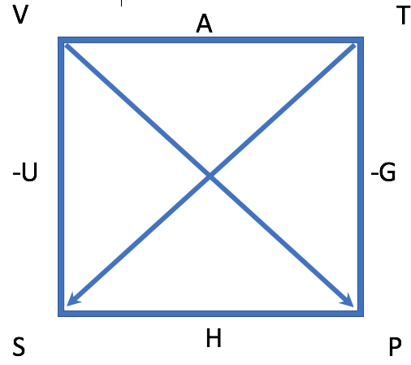
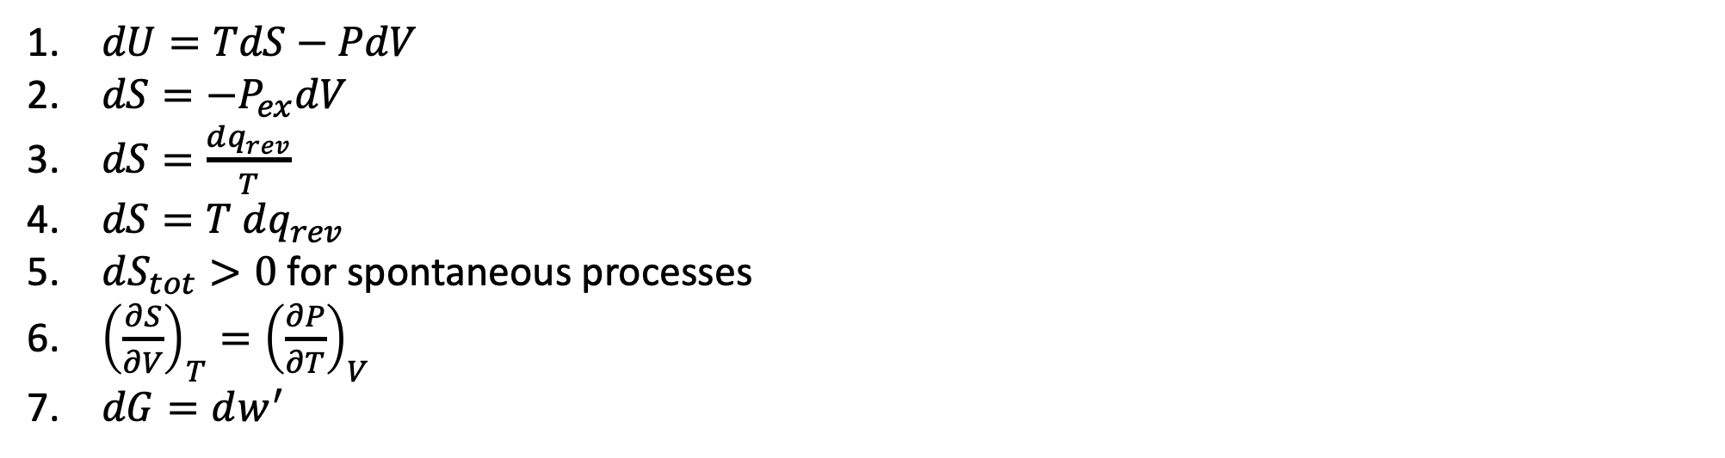
Weeks 10 & 11 – Entropy and the 2nd Law
$dU=TdS−PdV$
$dS=−P_{ex}dV$
$dS=\frac{dq_{rev}}{T}$
$dS=T dq_{rev}$
$dS_{tot}>0$ for spontaneous processes
${\left(\frac{∂S}{∂V}\right)}_{T}={\left(\frac{∂P}{∂T}\right)}_{V}$
$dG=dw^{′}$
Matching:
The Thermodynamic Definition of Entropy … (1-7)
The 2nd Law of Thermodynamics … (1-7)
One of the four fundamental equations of Thermodynamics … (1-7)
A Maxwell relation … (1-7)

Slide 16
Weeks 10 & 11 – Entropy and the 2nd Law
$dU=TdS−PdV$
$dS=−P_{ex}dV$
$dS=\frac{dq_{rev}}{T}$
$dS=T dq_{rev}$
$dS_{tot}>0$ for spontaneous processes
${\left(\frac{∂S}{∂V}\right)}_{T}={\left(\frac{∂P}{∂T}\right)}_{V}$
$dG=dw^{′}$
Matching:
The Thermodynamic Definition of Entropy … (3)
The 2nd Law of Thermodynamics … (5)
One of the four fundamental equations of Thermodynamics … (1)
A Maxwell relation … (6)

Slide 17
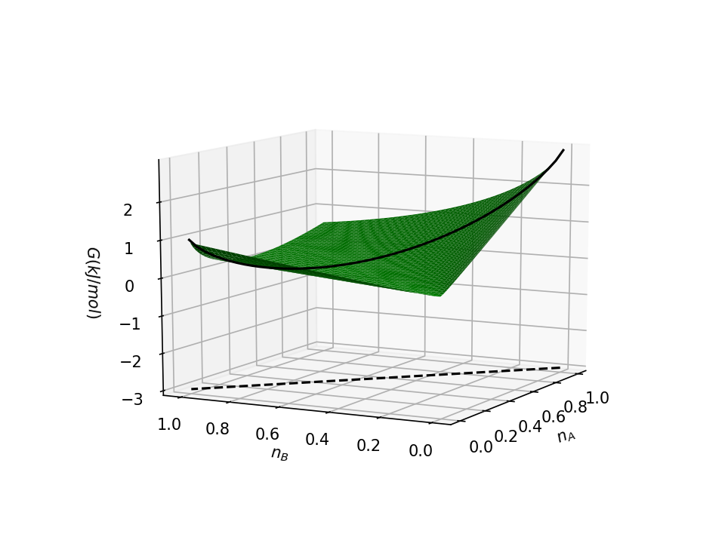
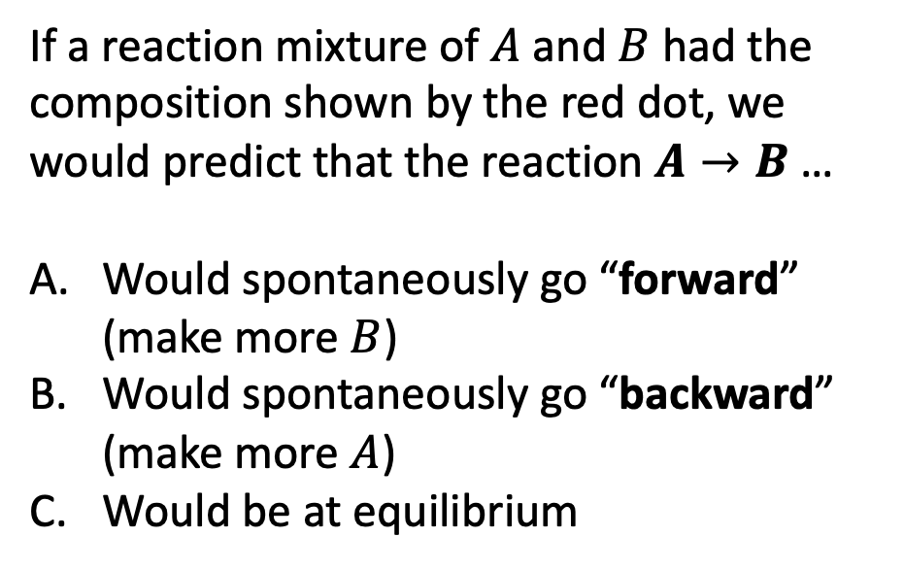
Week 12 – Gibbs energy of reaction
If a reaction mixture of $A$ and $B$ had the composition shown by the red dot, we would predict that the reaction $A→B$ …
Would spontaneously go “forward” (make more $B$)
Would spontaneously go “backward” (make more $A$)
Would be at equilibrium

Slide 18
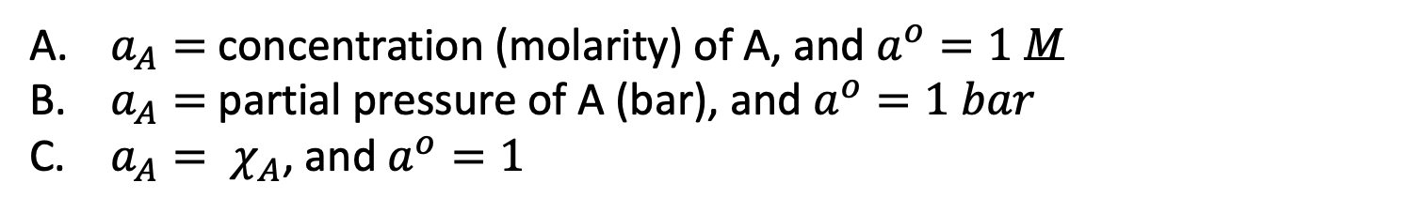

Week 12 – Chemical potentials
$$μ_{A}=μ_{A}^{o}+RT ln\frac{a_{A}}{a^{o}}$$
If A is a solvent, then
$a_{A}=$ concentration (molarity) of A, and $a^{o}=1$ $M$
$a_{A}=$ partial pressure of A (bar), and $a^{o}=1 bar$
$a_{A}= χ_{A}$, and $a^{o}=1$

Slide 19
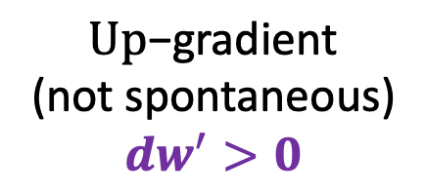
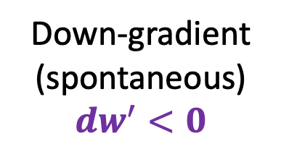
Week 13 – non-PV work
State “X”
$\text{U}\text{p}\text{−}\text{gradient}$
(not spontaneous)
$${dw}^{′}>0$$
Down-gradient
(spontaneous)
$${dw}^{′}<0$$
State “Y”
Which statement is true?
The Gibbs energy of “X” must be greater than “Y”
The Gibbs energy of “Y” must be greater than “X”
The Gibbs energy of “X” must be equal to “Y”

